Slide 1
Image Classification on the xView Dataset using FFNN
FFNN Challenge - Deep Learning Course
Authors: Mitesh Kumar, Fotis Chatzifotiadis

Slide 2
Challenge Objectives & Constraints
Objective: Classify satellite imagery from the xView dataset into 13 distinct categories (e.g., Cargo planes, Small cars, Buildings).
Constraint: Strictly utilize standard Feedforward Neural Networks (ffNNs), flattening the 224x224x3 images into a 150,528-feature 1D array.
The Core Challenge: Handling class imbalance and extracting features without using convolutional layers.

Slide 3
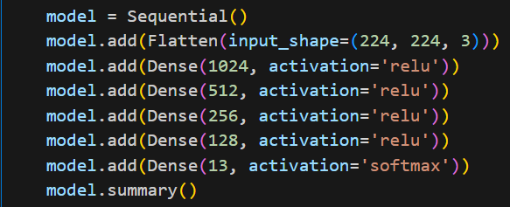
Model A
Architecture :
Batch Size: 64
Learning Rate of: 1e-4
Loss Function: categorical_crossentropy

Slide 4
Model A: Results
Validation Metrics Achieved:
Mean Accuracy: 47.360%
Mean Recall: 38.652%
Mean Precision: 42.469%

Slide 5
Model A: Architecture
The network gradually reduces the number of neurons in each layer (1024 → 512 → 256 → 128), so the information is compressed step by step. ReLU was used in the hidden layers because it works well in practice and is simple to implement. The model was trained using the Adam optimizer with a learning rate of 1e-4 and categorical cross-entropy loss, since this is a multi-class classification problem with one-hot labels. A batch size of 64 was chosen because it gave stable training and good validation results.

Slide 6
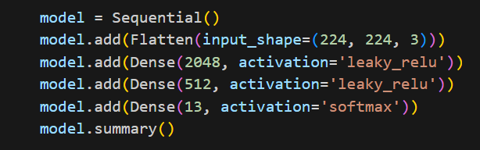
Model B
Architecture:
Batch Size: 16
Learning Rate: 5e-5
Loss Function: categorical_crossentropy

Slide 7
Model B: Results
Validation Metrics Achieved:
Mean Accuracy: 47.78%
Mean Recall: 43.86%
Mean Precision: 45.05%

Slide 8
Model Β: Architecture
The network has two hidden layers (2048 → 512), gradually reducing the number of neurons. Leaky ReLU was used in the hidden layers to allow small gradients for negative inputs. The final layer has 13 neurons with Softmax for multi-class classification. The model was trained with the Adam optimizer using a learning rate of 5e-5 and categorical cross-entropy loss. A batch size of 16 was chosen to provide more stable updates during training and better convergence, even though it increases the time per epoch.

Slide 9
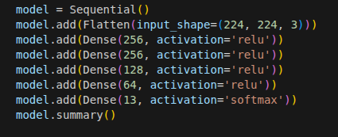
Model C:
Architecture:
Batch Size = 64
Learning rate = 1e-4
Loss function = categorical_crossentropy

Slide 10
Model C: Results
Validation Metrics Achieved:
Mean Accuracy: 43.62%
Mean Recall: 38.01%
Mean Precision: 37.89%

Slide 11
Model C: Architecture
The network gradually reduces the number of neurons in each hidden layer (256 → 256 → 128 → 64), forming a deep and narrow structure that compresses information progressively. ReLU was used in all hidden layers for simplicity and effective gradient propagation. The final layer has 13 neurons with Softmax for multi-class classification. The model was trained with the Adam optimizer using a learning rate of 1e-4 and categorical cross-entropy loss. A batch size of 64 was chosen to provide stable training and good validation results.

Slide 12
Comparative Analysis (Ablation Results)
Model | Batch Size | Learning Rate | Accuracy | Precision | Recall
A | 64 | 1e-4 | 47.36% | 42.26% | 38.65%
B | 16 | 5e-5 | 47.78% | 45.04% | 43.86%
C | 64 | 1e-4 | 43.62% | 38.01% | 37.89%

Slide 13
Final Test Set Evaluation (Codabench Submission)
Selected Model: Model B
Codabench Secret Test Set Scores:
Accuracy: 40.21%
Recall: 40.79%
Precision: 39.18%

Slide 14
Conclusions & Transition to Phase 2
We created three different architectures and tried different activation functions, learning rates and gained the test set metrics between
Next Steps (CNN Challenge): Feedforward networks destroy spatial hierarchies. Implementing Convolutional Neural Networks (CNNs) will allow the model to recognize 2D spatial features and push accuracy higher.

